Slide 1
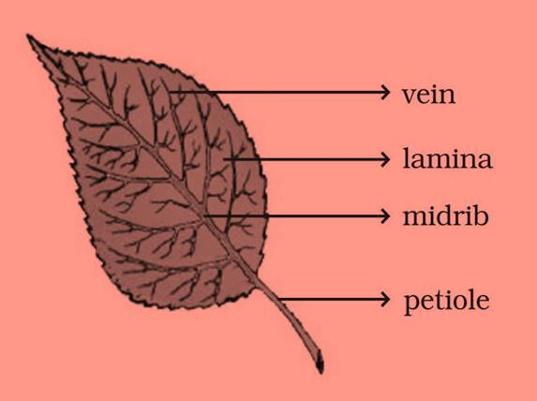
Leaf structure

Slide 2
LEAVES
A Leaf is an organ of a plant.
The part of a leaf by which it is attached to the stem is called Petiole.
The broad, green part of the leaf is called Lamina.
The lines on the leaf are called Veins and the thick vein in the middle is called the Midrib.
The design made by veins in a leaf is called the Leaf Venation.

Slide 3
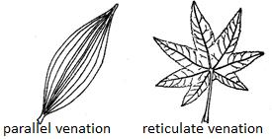
Types of venation

Slide 4
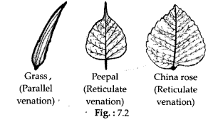

Slide 5
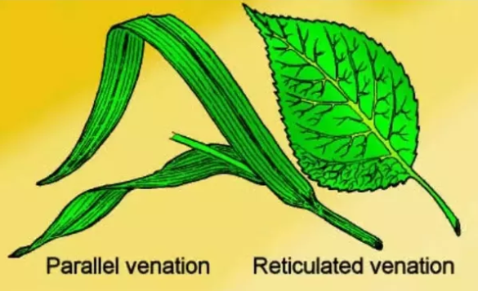

Slide 6
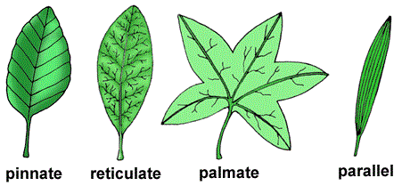
Other kinds of venation

